Slide 1

HOW TO PREPARE FOR YOUR TAX APPOINTMENT
BELSHAWACCOUNTING.COM
BELSHAW ACCOUNTING TAX AND ADVISORY SERVICES LLC
Notes:
1.7.2013
1.7.2013
Welcome to the "How to Get Prepared for Your Tax Appointment Seminar!" This seminar is designed to help you maximize the effectiveness of your tax appointment and ensure you have all the necessary documents and information ready. By following these steps, you'll be well-prepared, organized, and confident during your tax appointment. Let's get started!
‹#›
‹#›

Slide 2
BELSHAW ACCOUNTING
Belshaw Accounting and Tax Services, based in Tampa Bay, Florida, provides fully virtual and in person accounting and tax services to individuals and small business owners throughout the United States. We handle bookkeeping, accounting, payroll, individual and business taxes, business advisory and more.
ABOUT THE COMPANY
OUR STORY
TAX AND ADVISORY SERVICES LLC
“YOU ARE MORE THAN JUST NUMBERS TO US”

Slide 3

PRIOR YEAR TAX RETURNS
PERSONAL INFORMATION
INCOME DOCUMENTS
WHAT WE NEED FROM YOU ...
DEDUCTION DOCUMENTS
INVESTMENT DOCUMENTS
GATHER YOUR TAX DOCUMENTS
PROPERTY DOCUMENTS

Slide 4

PRIOR YEAR TAX RETURN
THE BEST REFERENCE FOR AN INITIAL TAX CLIENT IS TO LOOK AT LAST YEARS TAX RETURN.

Slide 5
  TAX PAYER, SPOUSE AND DEPENDENTS LEGAL NAME (MUST MATCH SOCIAL SECURITY CARD)
  DRIVERS LICENSE
  LEGAL ADDRESS
  DATES OF BIRTH
  SSN
  BANK ACCOUNT INFORMATION FOR REFUND (NAME OF BANK, ROUTING AND ACCOUNT TRANSIT NUMBER, IF CHECKING OR SAVINGS ACCOUNT)
  IRS PIN LETTER (IF APPLICABLE)
PERSONAL INFORMATION
BELSHAW ACCOUNTING

Slide 6
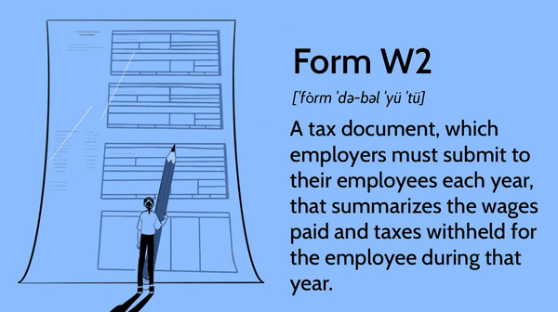

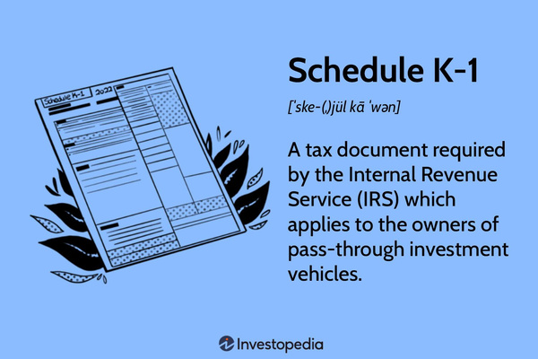
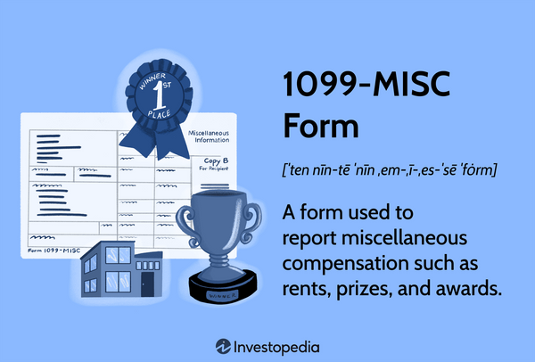
FORM W2
INCOME DOCUMENTS
FORM K-1
FORM 1099 (1099-SSA, 1099-R, 1099-MISC, 1099-NEC)
BELSHAW ACCOUNTING

Slide 7


DEDUCTION DOCUMENTS
BELSHAW ACCOUNTING
FORM 1098
FORM 1098-E
This form is provided by lenders and shows the mortgage interest paid during the year, which can be deducted if you itemize deductions.
This form reports student loan interest paid, which can be deducted up to a certain limit.
FORM 5498
FORM 8889
This form reports contributions to an individual retirement account (IRA), which may be deductible depending on the type of IRA and your income level.
This form is used to report contributions to and distributions from Health Savings Accounts (HSAs), along with deductions for HSA contributions.

Slide 8

FORM 1099-INT
Reports interest income earned from investments like savings accounts and CDs.
INVESTMENT DOCUMENTS
FORM 1099-DIV
Reports dividend income from stocks, mutual funds, and other investments.
FORM 1099-B
Reports proceeds from sales of stocks, mutual funds, and other securities transactions.

Slide 9

PROPERTY DOCUMENTS
HUD-1 SETTLEMENT STATEMENT
1098 MORTGAGE INTEREST STATEMENT
PROPERTY TAXES
Annual or semi-annual taxes imposed by local governments on real property, based on the assessed value of the property, used to fund public services like schools, police, and infrastructure.
A form used in real estate transactions, detailing all charges and credits to the buyer and seller in a property sale, including loan terms, closing costs, and other related expenses.
A tax form issued by lenders to borrowers, reporting the amount of mortgage interest paid during the tax year, which may be deductible on the borrower's tax return.

Slide 10
ORGANIZE YOUR FINANCIAL INFORMATION
MAKE A CHECKLIST OF ITEMS TO ASK YOUR TAX PROFESSIONAL
BEST PRACTICES FOR CLIENTS
FAMILIARIZE CHANGES IN TAX LAWS
RESEARCH TAX CREDITS AND DEDUCTIONS
REVIEW YOUR FINANCIAL GOALS
PREPARING FOR YOUR TAX RETURN
CONFIRM APPOINTMENT AND ARRIVE EARLY

Slide 11

ORGANIZE YOUR FINANCIAL INFORMATION
  Create a system to organize your financial records.
  Use folders, envelopes, or digital tools to categorize and store your documents.

Slide 12

  General Information
  Income
  Deductions and Credits
  Tax Planning
  Recordkeeping and Documentation
  Estimated Taxes
  E-Filing and Refunds
  Fees and Engagement
MAKE A CHECKLIST OF ITEMS TO ASK YOUR TAX PREPARER

Slide 13

  Stay updated on any changes in tax laws that might affect your tax return.
  Understand new deductions, credits, and rules that may apply to your situation.
FAMILIARIZE CHANGES IN TAX LAWS

Slide 14

RESEARCH TAX CREDITS AND DEDUCTIONS
  Some common credits include child tax credit, earned income tax credit, and education-related credits.

Slide 15

REVIEW YOUR FINANCIAL GOALS
  Review your financial goals for the upcoming year

Slide 16

CONFIRM APPOINTMENT AND ARRIVE EARLY
  Being punctual will allow you to start your session on time and prevent any unnecessary stress.

Slide 17

EVERYTHING YOU WANTED TO KNOW ABOUT YOUR TAXES BUT WERE AFRAID TO ASK

Slide 18

BELSHAW ACCOUNTING
TAX AVOIDANCE IS YOUR OBLIGATION,
tax evasion is 20 years
WHAT HAPPENS IF I DON'T PAY MY TAXES?
  Tax avoidance is your obligation—legally minimizing tax through compliance.
  Tax evasion, involving falsification or income concealment, results in severe penalties, including up to 20 years imprisonment.
  Fulfill your tax responsibilities to avoid legal repercussions and ensure compliance.

Slide 19

BELSHAW ACCOUNTING
QUIT GAMBLING WITH YOUR TAXES
"YOUR TAX RETURN CANNOT BE 99% CORRECT, ITS EITHER 100% CORRECT OR 100% WRONG."

Slide 20

BELSHAW ACCOUNTING
THE UNITED STATES TAX SYSTEM IS A PAY AS YOU GO, PROGRESSIVE TAX SYSTEM
THE UNITED STATES TAX SYSTEM OPERATES ON A PAY-AS-YOU-GO BASIS AND IS PROGRESSIVE IN NATURE.

Slide 21

BELSHAW ACCOUNTING
TOO MUCH INFORMATION IS AS BAD AS TOO LITTLE INFORMATION
GIVING INSUFFICIENT INFORMATION CAN BE AS PROBLEMATIC AS RECEIVING EXCESSIVE DETAILS, BOTH HINDERING ACCURATE PREPARATION OF YOUR TAX RETURNS

Slide 22
HOW TO MAKE TAX PREPARATION LESS STRESSFUL FOR YOU AND FOR US?
  COMMUNICATION
  COLLABORATION
  PREPARATION
  ORGANIZATION
  NO PROCASTINATION
BELSHAW ACCOUNTING

Slide 23

BUSINESS TAX STRATEGIES

Slide 24


HAVE A GOOD, SOLID, RELIABLE BOOKKEEPING
A good, solid, reliable bookkeeping system ensures accurate financial records and facilitates efficient tax preparation and compliance.

Slide 25
REVIEW PREVIOUS YEAR'S TAX RETURN
  Obtain a copy of your previous year's tax return
  Familiarize yourself with the information

Slide 26
UPDATE FINANCIAL STATEMENTS
  Prepare up-to-date financial statements
  Double-check accuracy

Slide 27

BELSHAW ACCOUNTING
DO
DONT’S
  Do have patience with your accountant.
  Do organize your financial documents before handing them to your accountant.
  Do respond promptly to your accountant's requests for information.
  Do schedule meetings in advance and respect your accountant’s time.
  Don't ask when your return will be done when you haven't provided all the info required to prepare your return.
  Don't rush your accountant
  Don't wait until the last minute to provide the necessary documents.
  Don't forget to review your return before signing and submitting it

Slide 28
REPORTING CRYPTO ACTIVITY CAN REQUIRE SEVERAL FORMS:
  Form 1040: Main form to file income taxes. Starting 2020 includes a question about cryptocurrency activity.
  Schedule D: Reports capital gains and losses from selling or trading assets, including crypto.
  Form 8949: Detailed report of sales or exchanges of capital assets. Filed with Schedule D.
  Schedule C: Reports income and expenses for self-employed individuals. It is necessary to earn crypto as a non-employee.
  Schedule SE: Calculates Social Security and Medicare taxes for self-employed income from crypto.
CRYPTO
CURRENCY TAXATION
REQUIRED TAX FORMS

Slide 29
  Individual Mandate: Penalty for not having health insurance (reduced to $0 in 2019).
  Premium Tax Credits: Subsidies to help pay for health insurance premiums, impacting tax returns.
  Medicaid Expansion: More individuals are eligible, which affects state taxes and benefits.
  Employer Mandate: Businesses with 50+ employees must provide health insurance or face penalties.
  Reporting Requirements: Employers and insurers must report coverage to the IRS, affecting tax documentation.
  Pre-existing Conditions: Insurers can't deny coverage, reducing uninsured rates and financial risk.
AFFORDABLE CARE ACT (ACA)

Slide 30
  Tax Deduction: Self-employed individuals can deduct health insurance premiums for themselves, their spouses, and dependents.
  Eligibility: Must have a net profit from self-employment or be a partner with net earnings.
  Qualifying Insurance: Health, dental, and long-term care insurance qualify for the deduction.
  Limits: Deduction cannot exceed the earned income from the business.
  Not Itemized: This deduction is taken "above the line," reducing adjusted gross income (AGI).
  Impact on Taxes: Lowers taxable income, potentially reducing overall tax liability.
  Reporting: Deduction is claimed on Schedule 1 (Form 1040).
SELF- EMPLOYED HEALTH INSURANCE PREMIUMS

Slide 31

COMMON FORMS

Slide 32
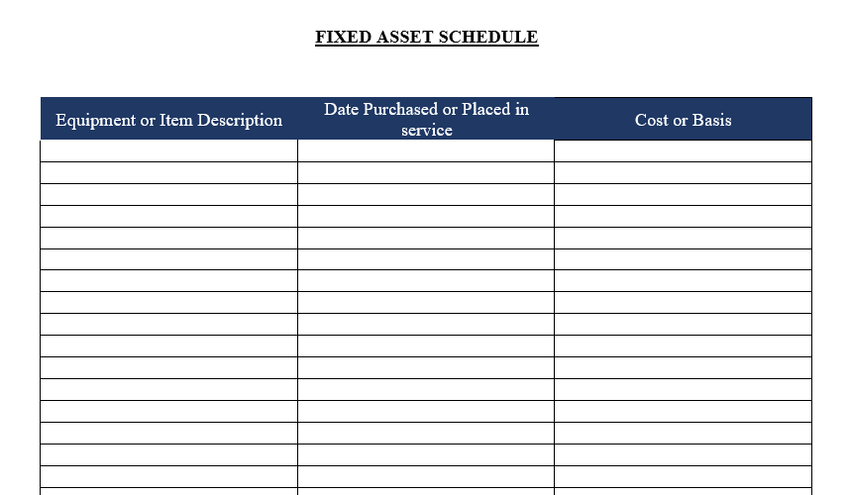
FIXED ASSET
SCHEDULE

Slide 33

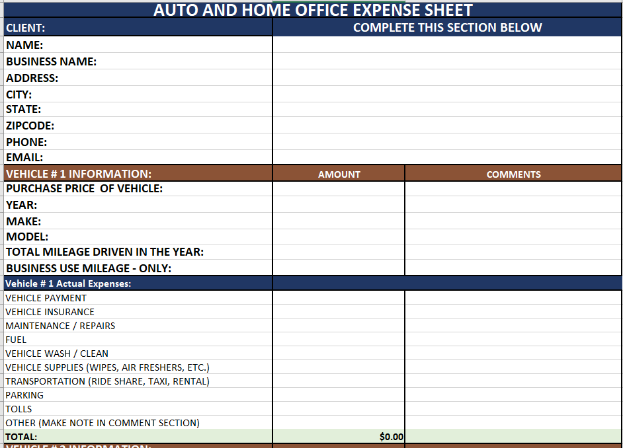
AUTO AND HOME OFFICE
EXPENSE SHEET

Slide 34
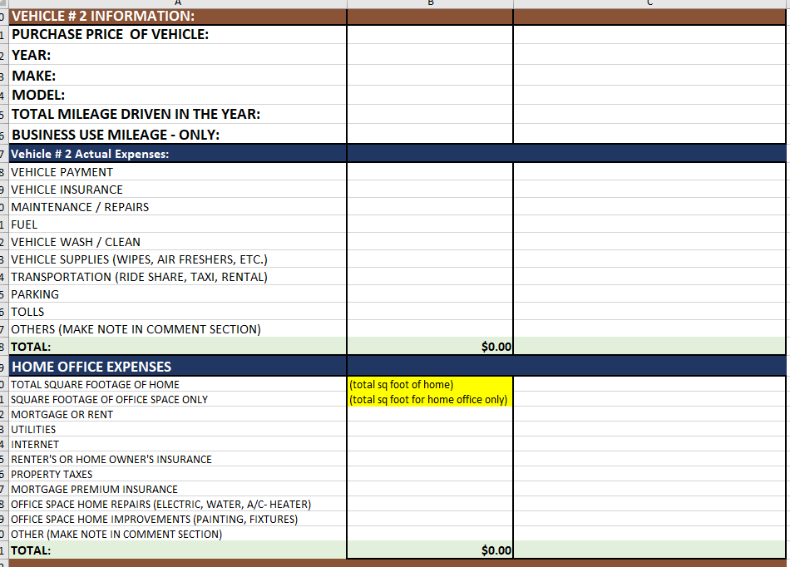
AUTO AND HOME OFFICE
EXPENSE SHEET

Slide 35

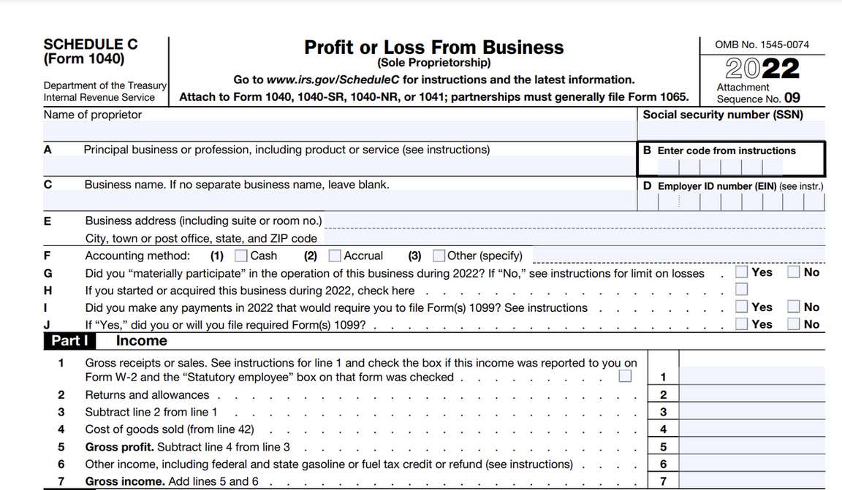
SCHEDULE C

Slide 36
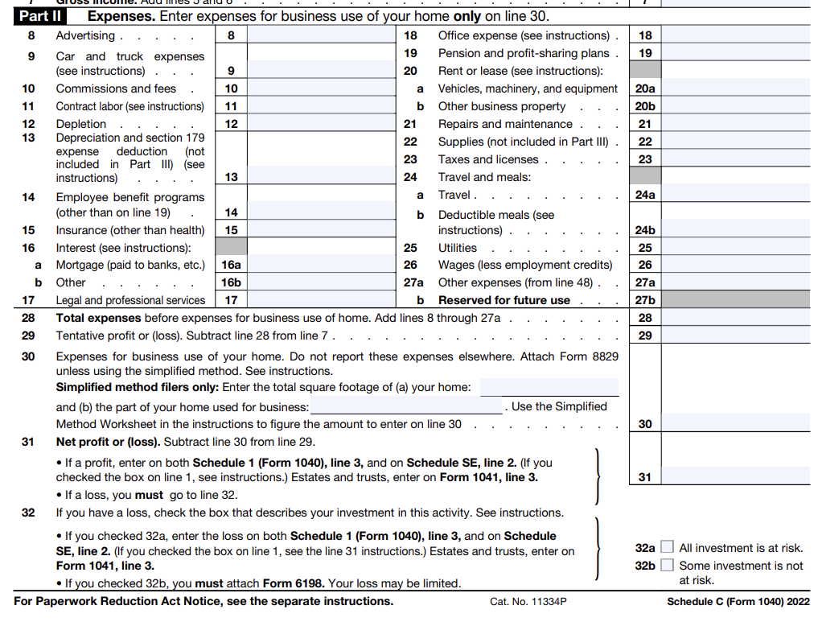
SCHEDULE C

Slide 37
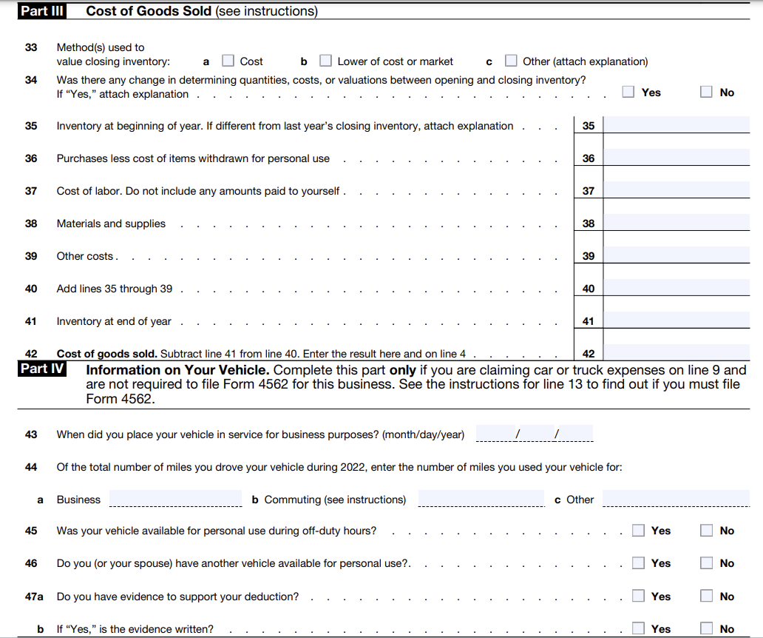
SCHEDULE C

Slide 38
SCHEDULE C

Slide 39

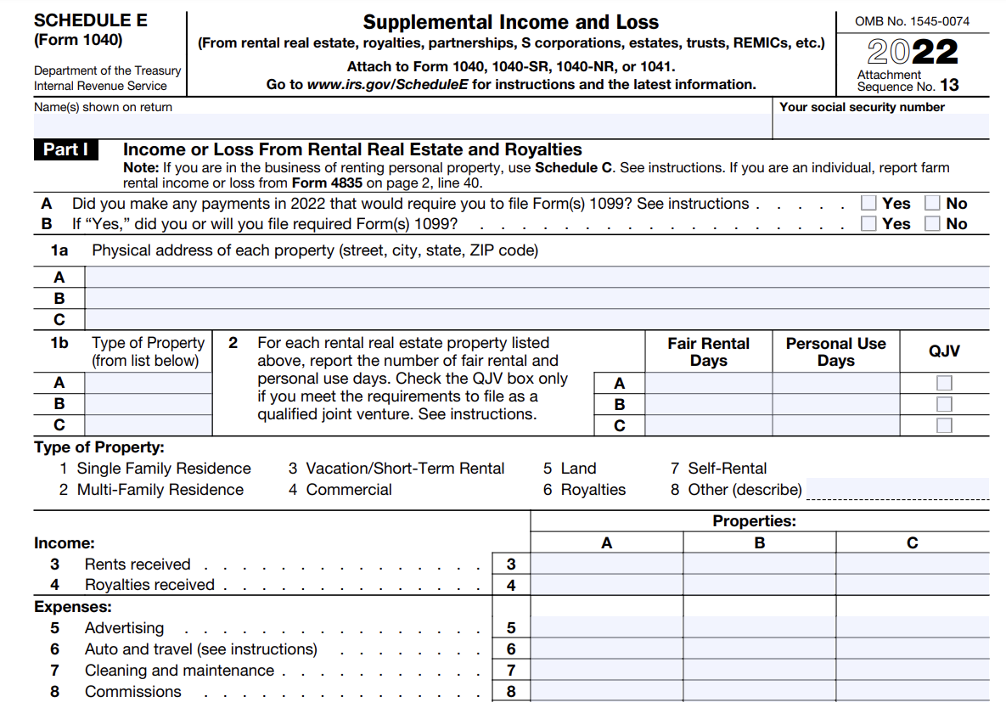
SCHEDULE E

Slide 40
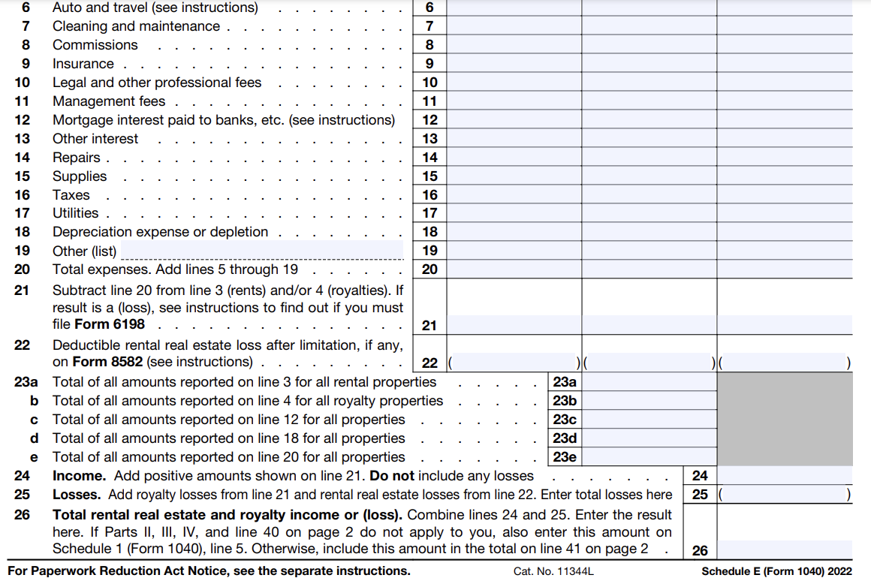
SCHEDULE E

Slide 41
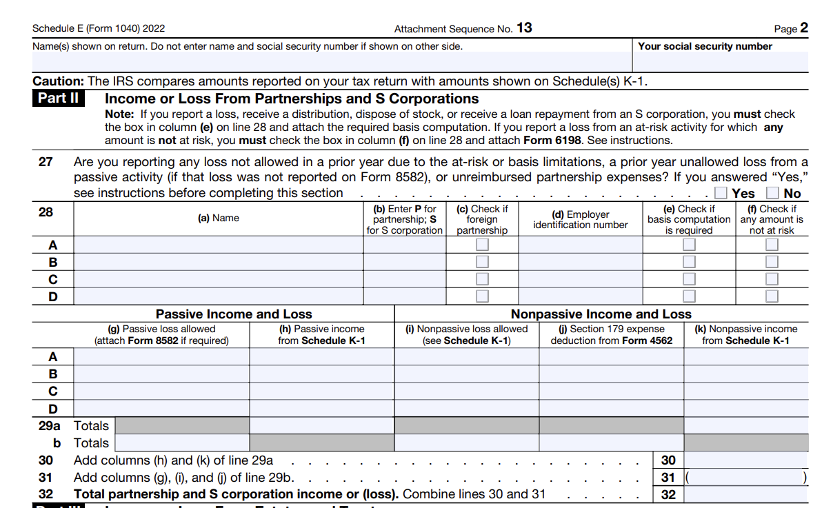
SCHEDULE E

Slide 42
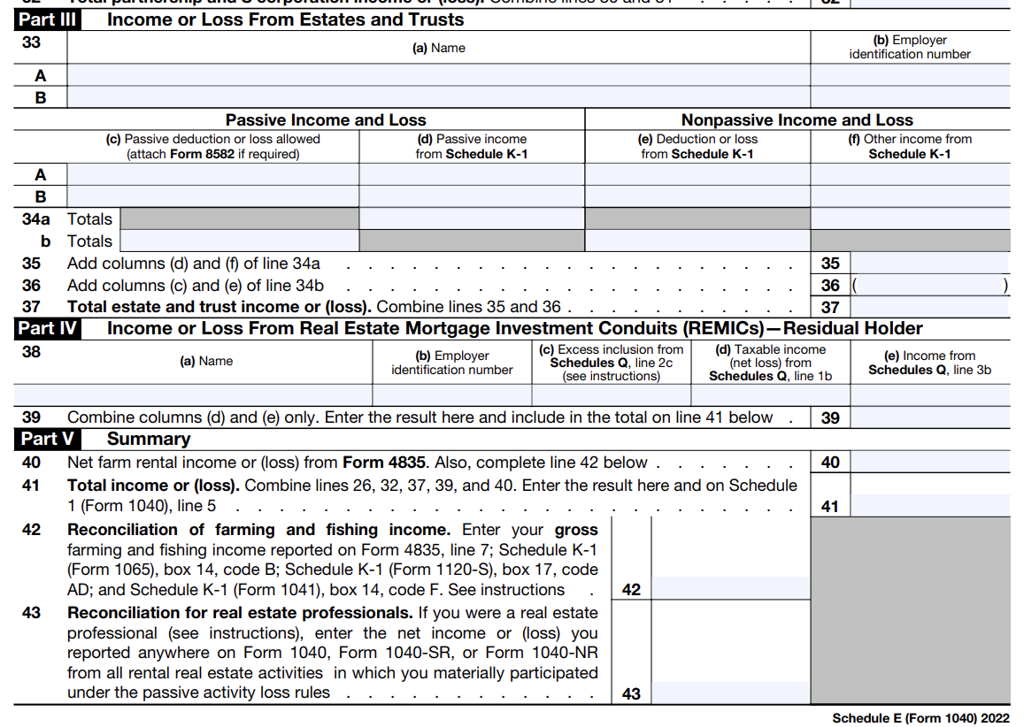
SCHEDULE E

Slide 43
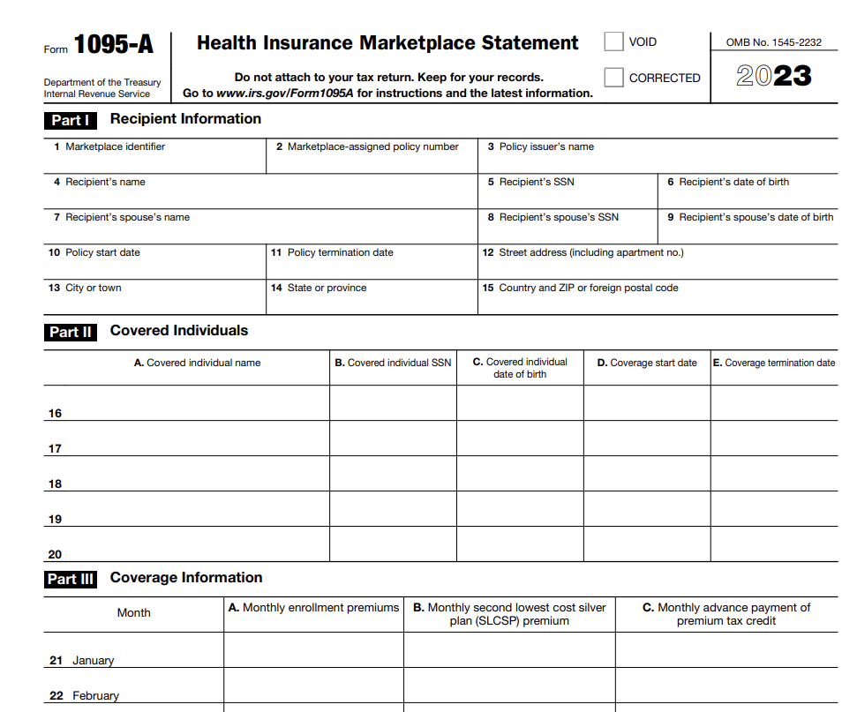
1095 A

Slide 44
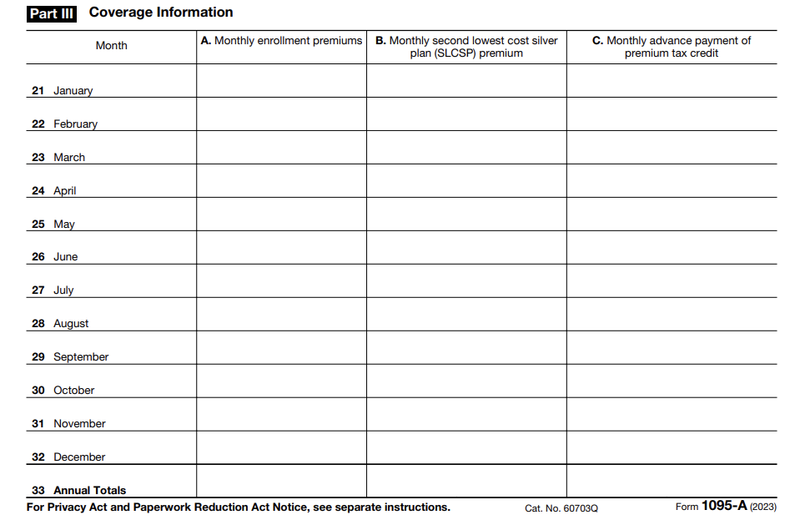
1095 A

Slide 45
SYSTEMS RUN THE BUSINESS, PEOPLE RUN THE SYSTEMS

Slide 46

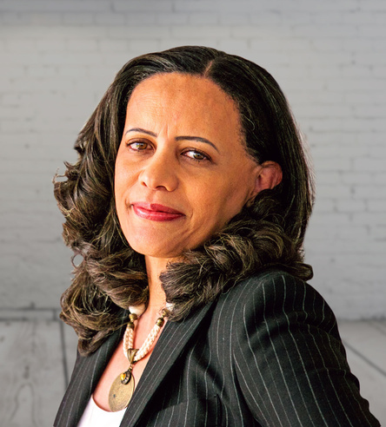
MEAT THE TEAM
PAUL BELSHAW
OWNER, TAX ADVISOR
Paul empowers clients nationwide with strategic accounting solutions to enhance financial security and achieve business goals, leveraging effective systems to ensure success.
GET TO KNOW US
ELIANE BELSHAW
PROFESSIONAL BUSINESS ANALYST
Eliane, a skilled Professional Business Analyst on Paul Belshaw's team, specializes in detailed business analyses for tax, accounting, and bookkeeping, utilizing tools such as Microsoft Office, Visio, and Pivot Tables to boost client productivity and profitability across the USA.
BELSHAWACCOUNTING.COM

Slide 47


NICOLE GREEN
MEAT THE TEAM
EA, CBP, NTPI
Nicole, an Enrolled Agent (EA) and Certified Bitcoin Professional (CBP), combines her extensive background in IRS representation and tax preparation with deep expertise in cryptocurrency, offering tailored financial guidance and services to a diverse clientele, including high net worth individuals and small businesses.
GET TO KNOW US
GENE DANIEL
TAX CONSULTANT
an experienced accountant with offices in New Jersey and the east coast of Florida, specializes in tax planning, financial consulting, and accounting, offering exceptional and personalized financial services to both individuals and businesses.
BELSHAWACCOUNTING.COM

Slide 48


ARLEN NACION
MEAT THE TEAM
STAFF ACCOUNTANT
Arlen, a certified Xero Advisor and QuickBooks ProAdvisor with over 20 years of experience, skillfully manages bookkeeping, accounting, and payroll for business clients, providing detailed financial statements and reports that support corporate objectives.
GET TO KNOW US
IVY FERHN NACION
EXECUTIVE ASSISTANT
The primary contact at our firm, dedicated to resolving inquiries and providing advice, demonstrating her commitment to achieving high client satisfaction
BELSHAWACCOUNTING.COM

Slide 49

E-MAIL:
info@belshawaccounting.com
PHONE:
CONTACT US
(727) 916 - 7410
ADDRESS:
3717 Cedarwood Drive, Holiday FL 34691
FOR INQUIRIES
WEB:
www.belshawaccounting.com

