Slide 1



TAX STRATEGIES FOR REAL ESTATE
Belshaw Accounting

Slide 2


ABOUT US
Belshaw Accounting and Tax Services, based in Tampa Bay, Florida, provides fully virtual services to small business owners throughout the United States. We handle bookkeeping, accounting, payroll, business taxes, and more.
At Belshaw Accounting and Tax Services, we believe that your small business deserves services that will help you thrive.
Since

Slide 3


THE ''SECRET'' TO BEATING THE IRS
"There is nothing wrong with a strategy to avoid the payment of taxes. The Internal Revenue Code doesn't prevent that".
-William H. Rehnquist

Slide 4

WHY TAX PLANNING?
1. Key to financial defense
2. Guarantee results

Slide 5


  Earned Income
  Interest/ Dividends
  Capital Gains
  Pension/IRA/ Annuity
  Rent/ Royalty
  Alimony
  Gambling Winnings
  "Other" Income
+ Add Taxable Income
- Minus Adjustments
- Minus Deductions
X (times Tax Bracket)
- Minus Tax Credit
TAXABLE INCOME

Slide 6
  IRA contributions
  Moving expenses
  1/2 SE tax
  SE health Insurance
  Keogh/ EP
  Alimony
  Student Loan Interest
+ Add Taxable Income
- Minus Adjustments
- Minus Deductions
X (times Tax Bracket)
- Minus Tax Credit
ADJUSTMENTS TO INCOME

Slide 7
STANDARD OR ITEMIZED DEDUCTIONS
Standard
Itemized
  Single
  HoH
  Marries/Joint
  Married/Separate
  Medical/Dental
  State/Local Taxes
  Foreign Taxes
  Interest
  Casualty/Theft Losses
  Charitable gifts
  Miscellaneous
Take the higher of the two amounts.

Slide 8
  Medical/ Dental
  State/ Local Taxes
  Foreign Taxes
  Interest
  Casualty/ Theft Losses
  Charitable Gifts
  Miscellaneous Itemized Deductions
+ Add Taxable Income
- Minus Adjustments
- Minus Deductions
X (times Tax Bracket)
- Minus Tax Credit
DEDUCTIONS/ EXEMPTIONS

Slide 9
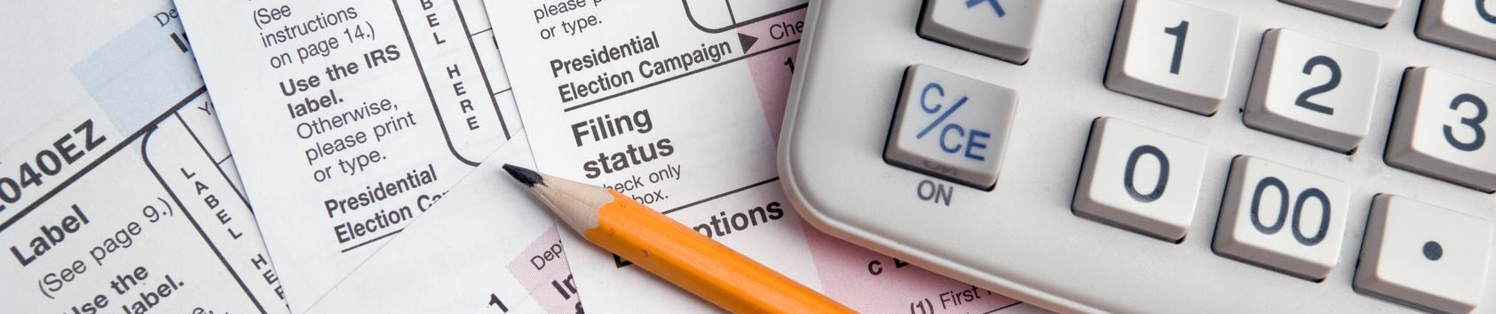
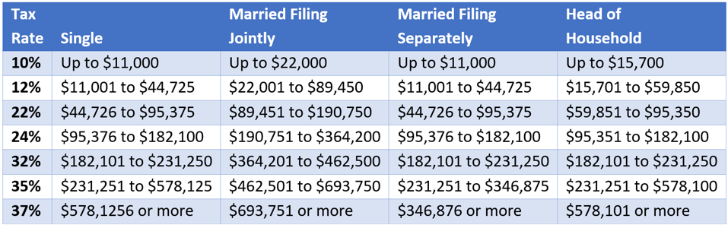
TAX BRACKET (2023)

Slide 10
  Family Credits
  Education Credits
  First-Time Homebuyer
  Foreign Tax
  General business
  Low-Income Housing
  Renovation
+ Add Taxable Income
- Minus Adjustments
- Minus Deductions
X (times Tax Bracket)
- Minus Tax Credit
TAX CREDITS

Slide 11

+ Add Taxable Income
- Minus Adjustments
  Pre- Tax Dollars
- Minus Deductions
X (times Tax Bracket)
- Minus Tax Credit
  After- Tax Dollars
TWO KINDS OF DOLLARS

Slide 12

KEYS TO CUTTING TAX
"You lose every time you spend after-tax dollars that could have been pre-tax dollars."
1. Earn as much nontaxable income as possible
2. Make the most of adjustments/deductions/credits
3. Shift income to later years if lower-brackets are anticipated

Slide 13

MAKE THE MOST OF DEPRECIATION
  Divide basis between "land" and "improvements".
  Assign as much as possible to depreciable improvements.
  The IRS suggests you use local property tax assessments.
  You can use any allocation (such as bank appraisal or your insurer's estimate of replacement costs) so long as you show "reasonable basis".
PROPERTY
Land
Not Depreciable
Improvements
27.5 - 39 years

Slide 14


BREAK OUT LAND IMPROVEMENTS
PROPERTY
Land
None
Land
Not Depreciable
Improvements
27.5 - 39 years
Improvements
15 years

Slide 15
BREAK OUT PERSONAL POROPERTY
PROPERTY
Land
Not Depreciable
Components
27.5 years
Improvements
27.5 - 39 years
Personal Property
5 years

Slide 16

PERSONAL PROPERTY EXAMPLES
  Cabinets
  Countertops
  Carpeting
  Dishwasher
  Microwave
  Oven/Range
  PA/Sound
  Refrigerator
  Security System
  Signage
  Stovetops
  Supp. Power
  Telephone
  Walls/Partitions
  Washer/Dryer
  Window Treats

Slide 17

REPAIRS VS. IMPROVEMENTS
Repairs | Improvements
Deductible now | Depreciable over time
Keep property in good operating condition | Adapt property to new use
Don't add value | Add value to property
Don't prolong property use | Prolong property use
Paint Plaster Repair Broken windows Fix gutter, floors, leaks | Room addition Upgrade appliances Landscaping Replace components

Slide 18
INVESTORS VS. DEALERS
Investors | Dealers
Buy as long-term investment | Buy with intent to resell in ordinary course of business
Avoid self-employment tax | Pay self-employment tax
Depreciation deductions | No depreciation deductions
Capital gains | Ordinary income
1031 Exchange | No 1031 exchange

Slide 19

THANK YOU

